Slide 1
Monitoring, Management and Security

Slide 2
What are network monitoring systems?
Network monitoring systems include software and hardware tools that can track various aspects of a network and its operation:
Traffic
Bandwidth utilization
Uptime; etc
Systems can detect devices and other elements that comprise or touch the network, as well as provide status updates.
Network administrators rely on network monitoring systems to help them quickly detect device or connection failures or issues such as traffic bottlenecks that limit data flow.
These systems can alert administrators to issues via email or text and deliver reports via network analytics.
Network monitoring systems use protocols to identify and report on network performance issues.

Slide 3
Network monitoring
Clear visibility into the network:
A clear picture of all the connected devices in the network
How data is moving among them
Identify and correct issues that can undermine performance and lead to outages.
Better use of IT resources
Hardware and software tools in to reduce manual work for IT teams.
Early insight into future infrastructure needs
The ability to identify security threats faster
Network monitoring protocols:
SNMP
ICMP
CDP - Cisco Discovery Protocol
Notes:
Network monitoring systems can provide reports on how network components have performed over a defined period. By analyzing these reports, network administrators can anticipate when the organization may need to consider upgrading or implementing new IT infrastructure.
Network monitoring helps organizations understand what "normal" performance looks like for their networks. So, when unusual activity occurs, such as an unexplained increase in network traffic levels, it's easier for administrators to identify the issue quickly--and to determine whether it may be a security threat.
SNMP: The Simple Network Management Protocol is an application-layer protocol that uses a call-and-response system to check statuses of many types of devices, from switches to printers. SNMP can be used to monitor system status and configuration.
ICMP: Network devices, such as routers and servers, use the Internet Control Message Protocol to send IP-operations information and to generate error messages in the event of device failures.
Cisco Discovery Protocol: The Cisco Discovery Protocol facilitates management of Cisco devices by discovering these devices, determining how they are configured, and allowing systems using different network-layer protocols to learn about one another.

Slide 4

Network management
Network management systems collect data from connected network devices such as switches, routers, access points, and client devices.
They also give network administrators fine-grained control over how those devices operate and interact with one another.
The data captured from these devices is used to proactively identify performance issues, monitor security and segmentation, and accelerate troubleshooting.
Notes:
The most effective systems combine devices and sensors into a single view of network traffic, making it easy for IT not only to monitor but to protect and remediate performance issues.
Typically, the data is collected and sent to the system in one of two ways:
By using protocols such as SNMP: SNMP queries each element in the network and sends each response to the network management system.
Streaming telemetry: A software agent installed in a network element allows for the automatic transmission of key performance indicators in real time. Streaming telemetry is rapidly replacing SNMP, because it is more efficient, can produce many more data points, and is more scalable.

Slide 5
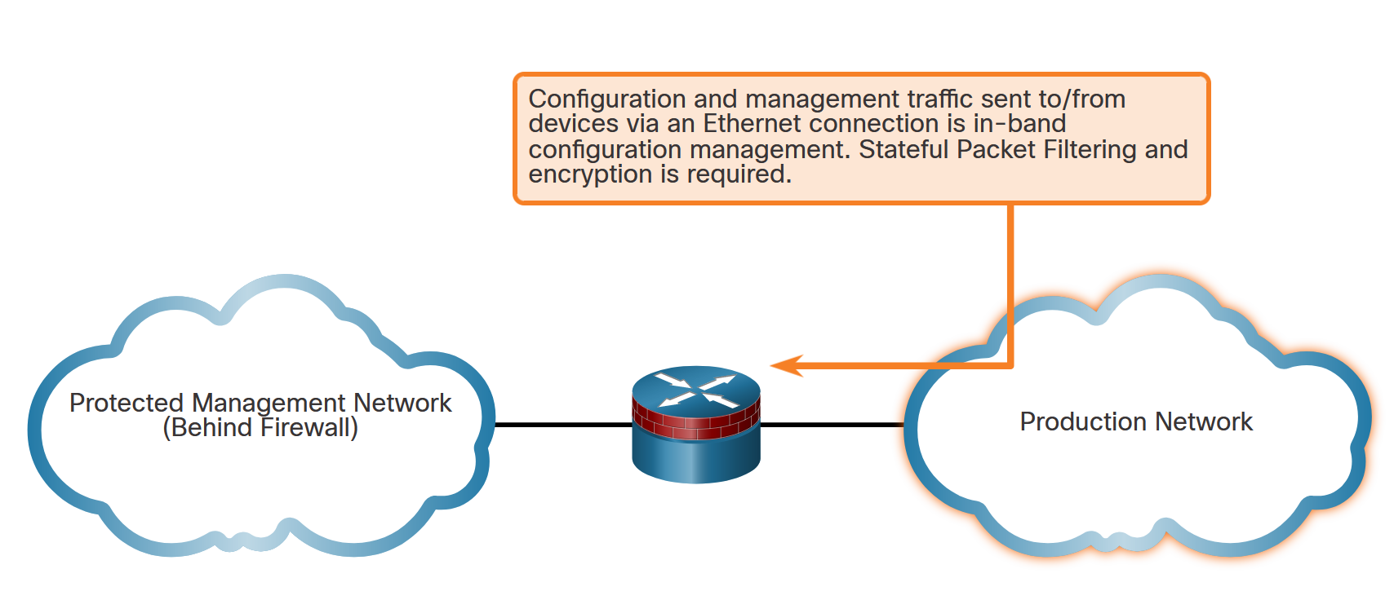
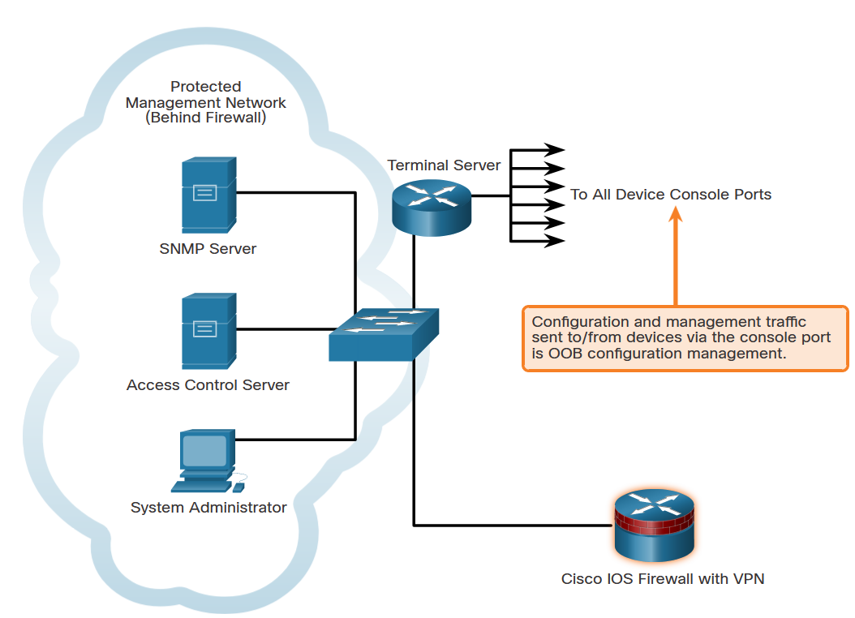
Types of Management Access
(From a reporting standpoint, most networking devices can send log data that can be invaluable when troubleshooting network problems or security threats. This data can be viewed in real time, on demand, and in scheduled reports.
When logging and managing information, the information flow between management hosts and the managed devices can take two paths:
In-band - Information flows across an enterprise production network, the Internet, or both, using regular data channels.
Out-of-band (OOB) - Information flows on a dedicated management network on which no production traffic resides.
Notes:
As a general rule, for security purposes, OOB management is appropriate for large enterprise networks. However, it is not always desirable. The decision to use OOB management depends on the type of management applications running and the protocols being monitored.
OOB management guidelines are:
Provide the highest level of security.
Mitigate the risk of passing insecure management protocols over the production network.
In-band management is recommended in smaller networks as a means of achieving a more cost-effective security deployment. In such architectures, management traffic flows in-band in all cases. It is made as secure as possible using secure management protocols, for example using SSH instead of Telnet.
In-band management guidelines are:
Apply only to devices that need to be managed or monitored.
Use IPsec, SSH, or SSL when possible.
Decide whether the management channel needs to be open at all times.

Slide 6
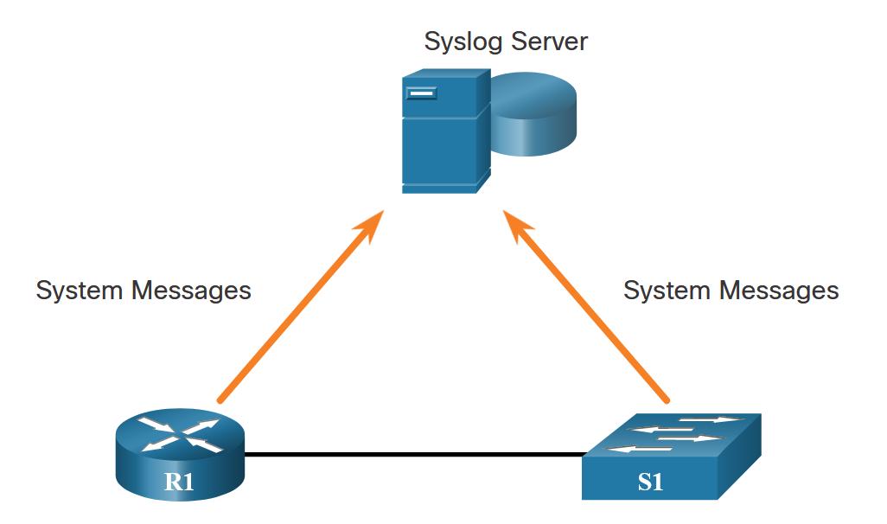
Introduction to Syslog
The most common method of accessing system messages is to use a protocol called syslog.
Syslog is a term used to describe a standard. It is also used to describe the protocol developed for that standard. Many networking devices support syslog, including routers, switches, application servers, firewalls, and other network appliances. The syslog protocol allows networking devices to send their system messages across the network to syslog servers.
The syslog logging service provides three primary functions, as follows:
The ability to gather logging information for monitoring and troubleshooting
The ability to select the type of logging information that is captured
The ability to specify the destinations of captured syslog messages
Notes:
It is possible to remotely monitor system messages by viewing the logs on a syslog server, or by accessing the device through Telnet, SSH, or through the console port.

Slide 7
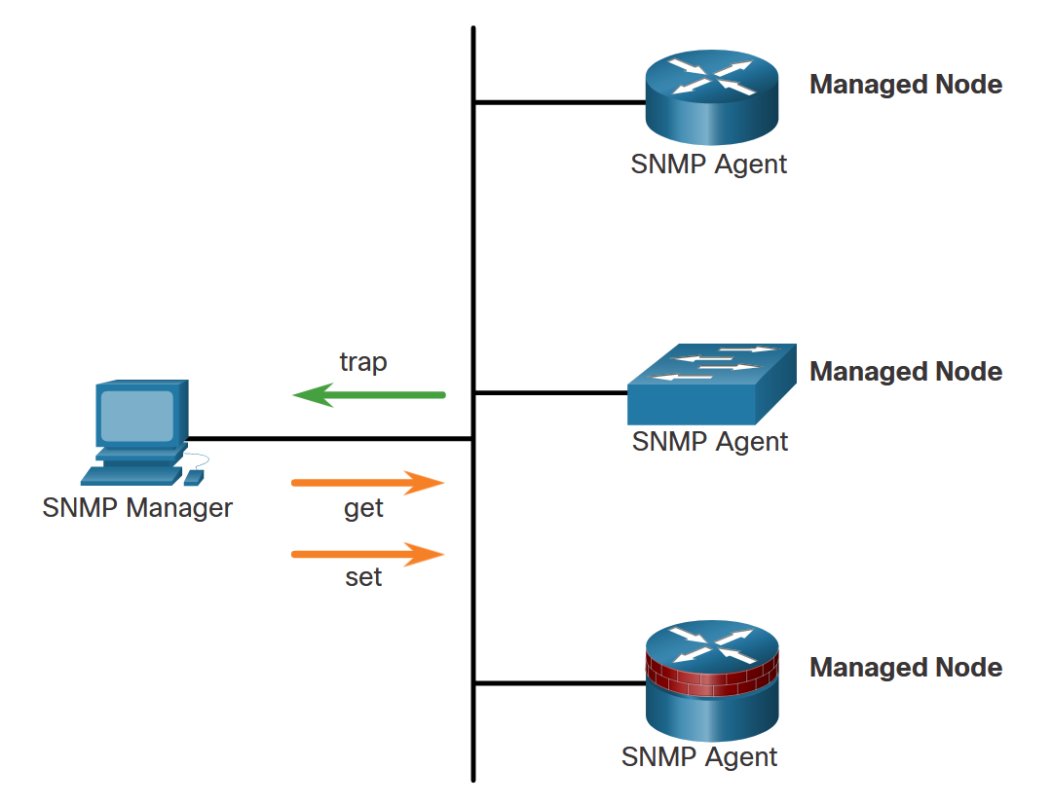
Introduction to SNMP
SNMP is an application layer protocol that provides a message format for communication between managers and agents.
The SNMP system consists of three elements:
SNMP manager
SNMP agents (managed node)
Management Information Base (MIB)
To configure SNMP on a networking device, it is first necessary to define the relationship between the manager and the agent.
The SNMP manager is part of a network management system (NMS). The SNMP manager runs SNMP management software.
As shown in the figure, the SNMP manager can collect information from an SNMP agent by using the “get” action. It can change configurations on an agent by using the “set” action. In addition, SNMP agents can forward information directly to a network manager by using “traps”.

Slide 8
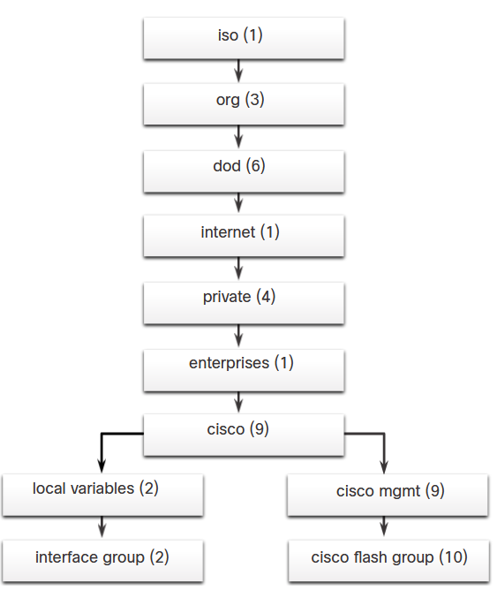
Management Information Base (MIB)
The MIB organizes variables hierarchically. MIB variables enable the management software to monitor and control the network device.
Formally, the MIB defines each variable as an object ID (OID). OIDs uniquely identify managed objects in the MIB hierarchy. The MIB organizes the OIDs based on RFC standards into a hierarchy of OIDs, usually shown as a tree.
The figure shows portions of the MIB structure defined by Cisco. Note how the OID can be described in words or numbers to help locate a particular variable in the tree. OIDs belonging to Cisco, are numbered as follows: .iso (1).org (3).dod (6).internet (1).private (4).enterprises (1).cisco (9). Therefore, the OID is 1.3.6.1.4.1.9.

Slide 9
SNMP Versions
Here are several versions of SNMP:
SNMPv1 - This is the Simple Network Management Protocol, a Full Internet Standard, that is defined in RFC 1157.
SNMPv2c - This is defined in RFCs 1901 to 1908. It uses a community-string-based Administrative Framework.
SNMPv3 - This is an interoperable standards-based protocol originally defined in RFCs 2273 to 2275. It provides secure access to devices by authenticating and encrypting packets over the network. It includes these security features: message integrity to ensure that a packet was not tampered with in transit, authentication to determine that the message is from a valid source, and encryption to prevent the contents of a message from being read by an unauthorized source.
All versions use SNMP managers, agents, and MIBs. Cisco IOS software supports the above three versions. Both SNMPv1 and SNMPv2c use a community-based form of security. The community of managers that is able to access the MIB of the agent is defined by a community string. SNMPv3 provides for both security models and security levels.

Slide 10
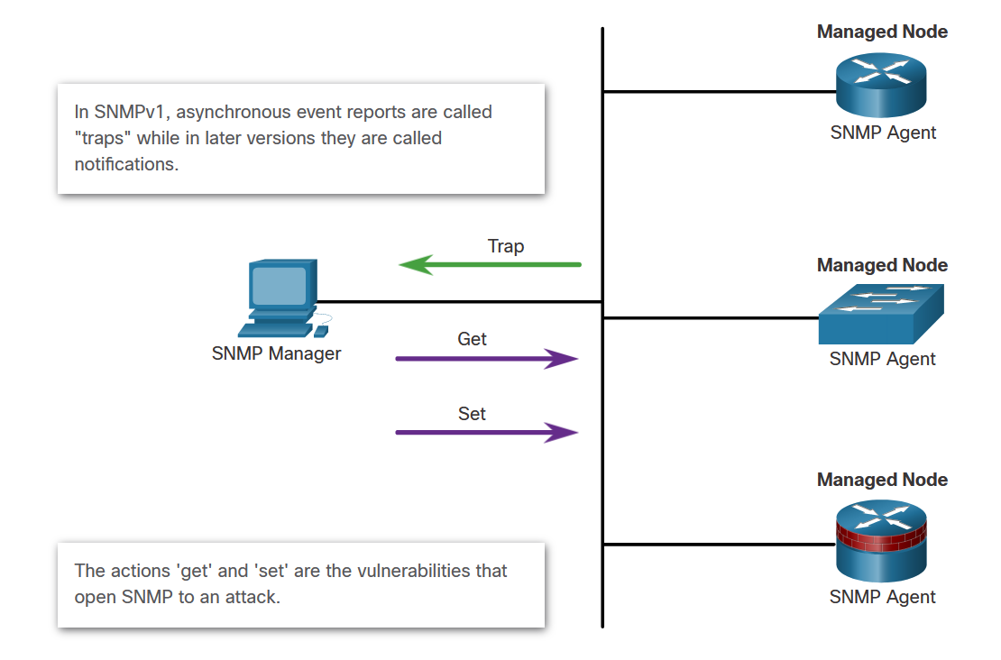
SNMP Vulnerabilities
In any network topology, at least one manager node should run SNMP management software. Network devices that can be managed, such as switches, routers, servers, and workstations, are equipped with the SNMP agent software module.
SNMP is vulnerable to attack precisely because SNMP agents can be polled with get requests and accept configuration changes with set requests, as shown in the figure.

Slide 11
SNMPv3
SNMPv3 provides three security features:
Message integrity and authentication - Ensures that a packet has not been tampered with in transit and is from a valid source.
Encryption - Scrambles the contents of a packet to prevent it from being seen by an unauthorized source.
Access control - Restricts each principal to certain actions on specific portions of data.

Slide 12
The NIST Internal/Interagency Report NISTIR 7298 (Glossary of Key Information Security Terms , May 2013) defines the term computer security as follows:
“ Measures and controls that ensure confidentiality, integrity, and availability of information system assets including hardware, software, firmware, and information being processed, stored, and communicated.”
Notes:
The NIST Internal/Interagency Report NISTIR 7298 (Glossary of Key Information
Security Terms , May 2013) defines the term computer security as follows:
Computer Security: Measures and controls that ensure confidentiality, integrity, and availability of information system assets including hardware, software, firmware, and information being processed, stored, and communicated.
This definition introduces three key objectives that are at the heart of computer security:
• Confidentiality: This term covers two related concepts:
— Data confidentiality : Assures that private or confidential information is not made available or disclosed to unauthorized individuals.
— Privacy : Assures that individuals control or influence what information related to them may be collected and stored and by whom and to whom that information may be disclosed.
• Integrity: This term covers two related concepts:
— Data integrity : Assures that information and programs are changed only in a specified and authorized manner.
— System integrity : Assures that a system performs its intended function in an unimpaired manner, free from deliberate or inadvertent unauthorized manipulation of the system.
• Availability: Assures that systems work promptly and service is not denied to authorized users.

Slide 13
Key Security Concepts: CIA and Communications Security
Confidentiality
Preserving authorized restrictions on information access and disclosure, including means for protecting personal privacy and proprietary information
Integrity
Guarding against improper information modification or destruction, including ensuring information nonrepudiation and authenticity
Availability
Ensuring timely and reliable access to and use of information
Notes:
• Confidentiality: Preserving authorized restrictions on information access and disclosure, including means for protecting personal privacy and proprietary information. A loss of confidentiality is the unauthorized disclosure of information.
• Integrity: Guarding against improper information modification or destruction, including ensuring information non-repudiation and authenticity. A loss of integrity is the unauthorized modification or destruction of information.
• Availability: Ensuring timely and reliable access to and use of information. A loss of availability is the disruption of access to or use of information or an information system.
Although the use of the CIA triad to define security objectives is well established, some in the security field feel that additional concepts are needed to present a complete picture. Two of the most commonly mentioned are as follows:
• Authenticity: The property of being genuine and being able to be verified and trusted; confidence in the validity of a transmission, a message, or message originator. This means verifying that users are who they say they are and that each input arriving at the system came from a trusted source.
• Accountability: The security goal that generates the requirement for actions of an entity to be traced uniquely to that entity. This supports nonrepudiation, deterrence, fault isolation, intrusion detection and prevention, and after-action recovery and legal action. Because truly secure systems aren’t yet an achievable goal, we must be able to trace a security breach to a responsible party. Systems must keep records of their activities to permit later forensic analysis to trace security breaches or to aid in transaction disputes.
Authenticity can be included under integrity.

Slide 14
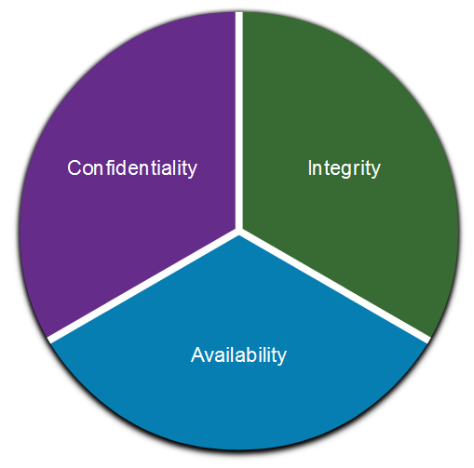
Communications Security: CIA
Information security deals with protecting information and information systems from unauthorized access, use, disclosure, disruption, modification, or destruction. The CIA Triad serves as a conceptual foundation for the field.
Notes:
These three concepts form what is often referred to as the CIA triad . The three concepts embody the fundamental security objectives for both data and for information and computing services. For example, the NIST standard FIPS 199 (Standards for Security
Categorization of Federal Information and Information Systems , February 2004) lists confidentiality, integrity, and availability as the three security objectives for information and for information systems.
To the CIA triad, one may add ( in the context of secure communication and exchange of data):
Data Non-Repudiation - Guarantees that the sender cannot repudiate, or refute, the validity of a message sent. Nonrepudiation relies on the fact that only the sender has the unique characteristics or signature for how that message is treated.

Slide 15
Key Security Concepts: AAA and Communications Security
Authentication: Verification that the credentials of a user or other system entity are valid.
Authorization: The granting of a right or permission to a system entity to access a system resource. This function determines who is trusted for a given purpose.
Accounting: Accounting provides a method for collecting information, logging the information for auditing and reporting.
Audit: An independent review and examination of system records and activities in order to test for adequacy of system controls, to ensure compliance with established policy and operational procedures, to detect breaches in security, and to recommend any indicated changes in control, policy and procedures.
The AAA serves as a conceptual foundation for the field.
Source: Based on [SAND94].
Notes:
An access control mechanism mediates between a user (or a process executing on behalf of a user) and system resources, such as applications, operating systems, firewalls, routers, files, and databases.
The system must first authenticate an entity seeking access. Typically, the authentication function determines whether the user is permitted to access the system at all.
Then the access control function determines if the specific requested access by this user is permitted.
An auditing function monitors and keeps a record of user accesses to system resources.

Slide 16
NIST SP 800-63-3 (Digital Authentication Guideline, October 2016) defines digital user authentication as:
“The process of establishing confidence in user identities that are presented electronically to an information system.”
Notes:
NIST SP 800-63-3 (Digital Authentication Guideline , October 2016) defines digital user authentication as the process of establishing confidence in user identities that are presented electronically to an information system.
Systems can use the authenticated identity to determine if the authenticated individual is authorized to perform particular functions, such as database transactions or access to system resources.
In many cases, the authentication and transaction, or other authorized function, take place across an open network such as the Internet.
Equally authentication and subsequent authorization can take place locally, such as across a local area network.

Slide 17
The four means of authenticating user identity are based on:
Something the individual knows
Password, PIN, answers to prearranged questions
Something the individual possesses (token)
Smartcard, electronic keycard, physical key
Something the individual is (static biometrics)
Fingerprint, retina, face
Something the individual does (dynamic biometrics)
Voice pattern, handwriting, typing rhythm
Notes:
There are four general means of authenticating a user's identity, which can be used alone or in combination:
• Something the individual knows: Examples includes a password, a personal identification number (PIN), or answers to a prearranged set of questions.
• Something the individual possesses: Examples include electronic keycards, smart cards, and physical keys. This type of authenticator is referred to as a token.
• Something the individual is (static biometrics): Examples include recognition by fingerprint, retina, and face.
• Something the individual does (dynamic biometrics): Examples include recognition by voice pattern, handwriting characteristics, and typing rhythm.
All of these methods, properly implemented and used, can provide secure user authentication.
However, each method has problems:
An adversary may be able to guess or steal a password.
Similarly, an adversary may be able to forge or steal a token.
A user may forget a password or lose a token.
etc
Further, there is a significant administrative overhead for managing password and token information on systems and securing such information on systems.
With respect to biometric authenticators, there are a variety of problems, including dealing with false positives and false negatives, user acceptance, cost, and convenience.

Slide 18
Access Control Definitions 1/2
NISTIR 7298 defines access control as:
“the process of granting or denying specific requests to: (1) obtain and use information and related information processing services; and (2) enter specific physical facilities”
Notes:
Two definitions of access control are useful in understanding its scope.
1. NISTIR 7298 (Glossary of Key Information Security Terms , May 2013), defines access control as the process of granting or denying specific requests to: (1) obtain and use information and related information processing services;
And (2) enter specific physical facilities.

Slide 19
Access Control Definitions 2/2
RFC 4949 defines access control as:
“a process by which use of system resources is regulated according to a security policy and is permitted only by authorized entities (users, programs, processes, or other systems) according to that policy”
Notes:
RFC 4949, Internet Security Glossary , defines access control as a process by which use of system resources is regulated according to a security policy and is permitted only by authorized entities (users, programs, processes, or other systems) according to that policy.

Slide 20
Access Control Principles
In a broad sense, all of computer security is concerned with access control
RFC 4949 defines computer security as:
“measures that implement and assure security services in a computer system, particularly those that assure access control service”
Notes:
In a broad sense, all of computer security is concerned with access control.
Indeed, RFC 4949 defines computer security as follows: measures that implement and assure security services in a computer system, particularly those that assure access control service.
Access control implements a security policy that specifies who or what (e.g., in the case of a process) may have access to each specific system resource, and the type of access that is permitted in each instance.

Slide 21
Network Security Policies
Network Security Domains
There are 14 network security domains specified by the International Organization for Standardization (ISO)/International Electrotechnical Commission (IEC).
Network Security Domain | Description
Information Security Policies | This annex is designed to ensure that security policies are created, reviewed, and maintained.
Organization of Information Security | This is the governance model set out by an organization for information security. It assigns responsibilities for information security tasks within in organization.
Human Resources Security | This addresses security responsibilities relating to employees joining, moving within, and leaving an organization.
Asset Management | This concerns the way that organizations create an inventory of and classification scheme for information assets.
Access Control | This describes the restriction of access rights to networks, systems, applications, functions, and data.
Cryptography | This concerns data encryption and the management of sensitive information to protect confidentiality, integrity, and availability of data.
Physical and Environmental Security | This describes the protection of the physical computer facilities and equipment within an organization.

Slide 22
Network Security Policies
Network Security Domains (Cont.)
Network Security Domain | Description
Operations Security | This describes the management of technical security controls in systems and networks including malware defenses, data backup, logging and monitoring, vulnerability management, and audit considerations. This domain is also concerned with the integrity of software that is used in business operations.
Communications Security | This concerns the security of data as it is communicated on networks, both within an organization or between and organization and third parties such as customers or suppliers.
System Acquisition, Development, and Maintenance | This ensures that information security remains a central concern in an organization’s processes across the entire lifecycle, in both private and public networks.
Supplier Relationships | This concerns the specification of contractual agreements that protect an organization’s information and technology assets that are accessible by third parties that provide supplies and services to the organization.
Information Security Incident Management | This describes how to anticipate and respond to information security breaches.

Slide 23
Network Security Policies
Network Security Domains (Cont.)
Network Security Domain | Description
Business Continuity Management | This describes the protection, maintenance, and recovery of business-critical processes and systems.
Compliance | This describes the process of ensuring conformance with information security policies, standards, and regulations.

Slide 24
Further definitions: What is network security?
Confidentiality: only sender, intended receiver should “understand” message contents
sender encrypts message
receiver decrypts message
Authentication: sender, receiver want to confirm identity of each other
Message integrity: sender, receiver want to ensure message not altered (in transit, or afterwards) without detection
Access and Availability: services must be accessible and available to users
And? Are we including all concepts in CIA and AAA models?
Notes:
Q: What can a “bad guy” do?
A: A lot!
eavesdrop: intercept messages
actively insert messages into connection
impersonation: can fake (spoof) source address in packet (or any field in packet)
hijacking: “take over” ongoing connection by removing sender or receiver, inserting himself in place
denial of service: prevent service from being used by others (e.g., by overloading resources)

Slide 25



Friends and enemies: Alice, Bob, Trudy
well-known in network security world
Bob, Alice (lovers!) want to communicate “securely”
Trudy (intruder) may intercept, delete, add messages
Alice
channel
data, control messages
Bob
secure
sender
secure
receiver
data
data
Trudy
Notes:
Who might Bob and Alice be?
… well, real-life Bobs and Alices!
Web browser/server for electronic transactions (e.g., on-line purchases)
on-line banking client/server
DNS servers
BGP routers exchanging routing table updates
other examples?

Slide 26
The language of cryptography
Alice’s
encryption
key
Bob’s
decryption
key
K
A
K
B
plaintext
encryption
algorithm
ciphertext
decryption
algorithm
plaintext
m: plaintext message
K_{A}(m): ciphertext, encrypted with key K_{A}
m = K_{B}(K_{A}(m))

Slide 27
Breaking an encryption scheme
cipher-text only attack: Trudy has ciphertext she can analyze
two approaches:
brute force: search through all keys
statistical analysis
known-plaintext attack: Trudy has plaintext corresponding to ciphertext
e.g., in monoalphabetic cipher, Trudy determines pairings for a,l,i,c,e,b,o,
chosen-plaintext attack: Trudy can get ciphertext for chosen plaintext

Slide 28
Symmetric key cryptography
K
K
S
S
plaintext
encryption
algorithm
ciphertext
decryption
algorithm
plaintext
K (m)
S
symmetric key crypto: Bob and Alice share same (symmetric) key: K
e.g., key is knowing substitution pattern in mono alphabetic substitution cipher
Q: how do Bob and Alice agree on key value?

Slide 29
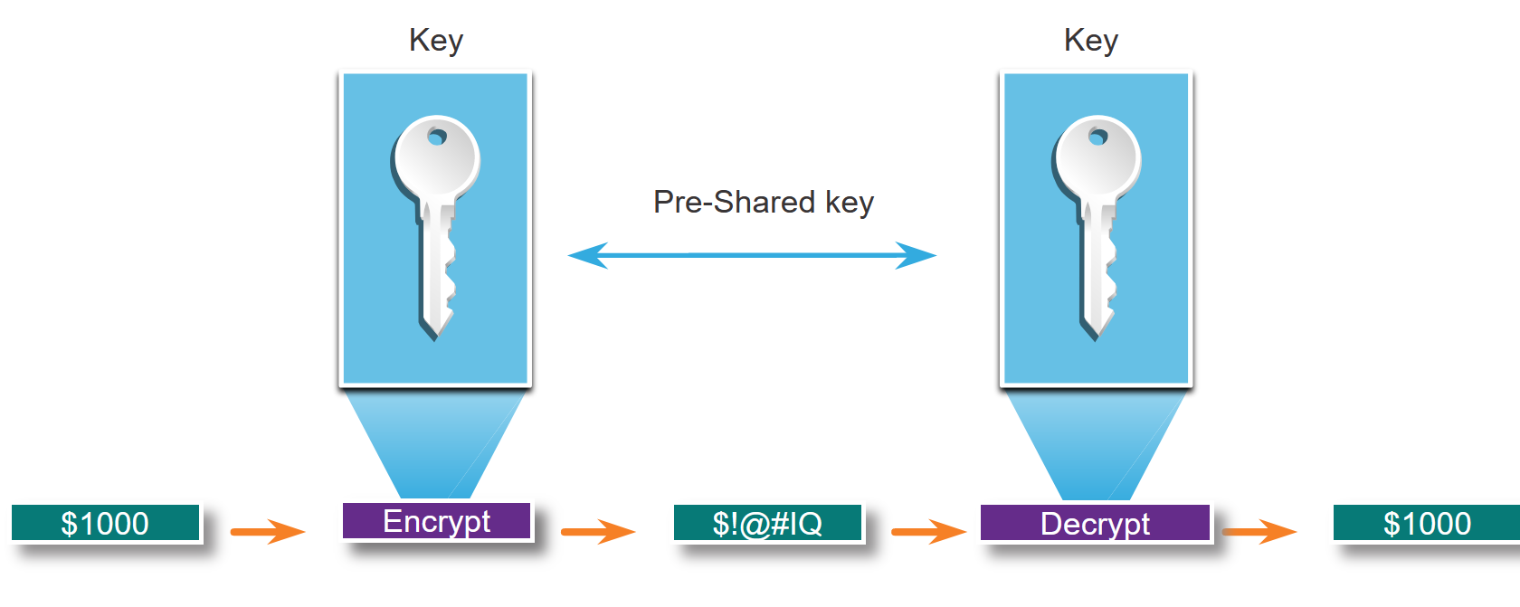
Confidentiality
Symmetric Encryption
Symmetric algorithms use the same pre-shared key to encrypt and decrypt data. A pre-shared key, also called a secret key, is known by the sender and receiver before any encrypted communications can take place.
In the figure, Alice and Bob have identical keys to a single padlock. These keys were exchanged prior to sending any secret messages.
Conceptually: Alice writes a secret message and puts it in a small box that she locks using the padlock with her key. She mails the box to Bob. The message is safely locked inside the box as the box makes its way through the post office system. When Bob receives the box, he uses his key to unlock the padlock and retrieve the message. Bob can use the same box and padlock to send a secret reply back to Alice.

Slide 30
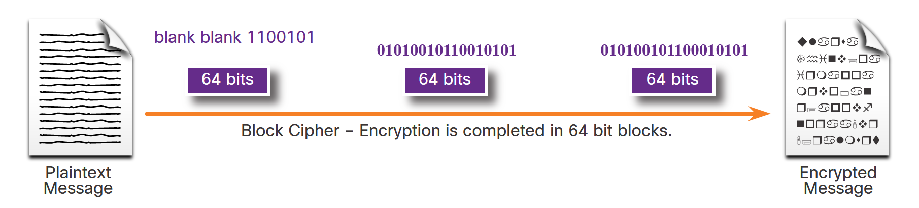
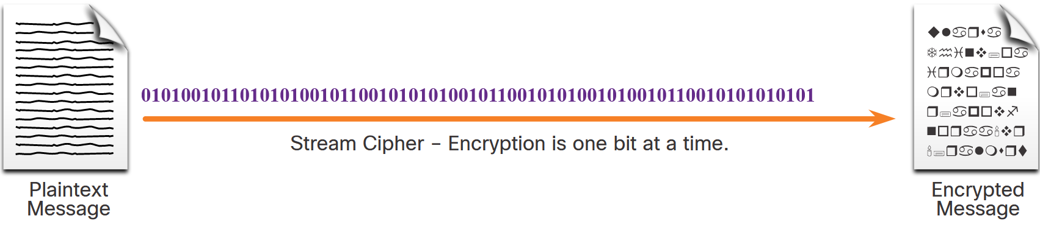
Symmetric Encryption (Cont.)
Symmetric encryption algorithms are sometimes classified as either a block cipher or a stream cipher.
Block ciphers transform a fixed-length block of plaintext into a common block of ciphertext of 64 or 128 bits. Common block ciphers include DES with a 64-bit block size and AES with a 128-bit block size.
Stream ciphers encrypt plaintext one byte or one bit at a time. Stream ciphers are basically a block cipher with a block size of one byte or bit. Stream ciphers are typically faster than block ciphers because data is continuously encrypted.

Slide 31
Simple encryption scheme
substitution cipher: substituting one thing for another
monoalphabetic cipher: substitute one letter for another
plaintext: abcdefghijklmnopqrstuvwxyz
ciphertext: mnbvcxzasdfghjklpoiuytrewq
e.g.:
Plaintext: bob. i love you. alice
ciphertext: nkn. s gktc wky. mgsbc
Encryption key: mapping from set of 26 letters
to set of 26 letters

Slide 32
A more sophisticated encryption approach
n substitution ciphers, M₁,M₂,…,M_{n}
cycling pattern:
e.g., n=4: M₁,M₃,M₄,M₃,M₂; M₁,M₃,M₄,M₃,M₂; ..
for each new plaintext symbol, use subsequent substitution pattern in cyclic pattern
dog: d from M₁, o from M₃, g from M₄
Encryption key: n substitution ciphers, and cyclic pattern
key need not be just n-bit pattern

Slide 33
Symmetric key crypto: DES
DES: Data Encryption Standard
US encryption standard [NIST 1993]
56-bit symmetric key, 64-bit plaintext input
block cipher with cipher block chaining
how secure is DES?
DES Challenge: 56-bit-key-encrypted phrase decrypted (brute force) in less than a day
no known good analytic attack
making DES more secure:
3DES: encrypt 3 times with 3 different keys

Slide 34
AES: Advanced Encryption Standard
symmetric-key NIST standard, replaced DES (Nov 2001)
processes data in 128 bit blocks
128, 192, or 256 bit keys
brute force decryption (try each key) taking 1 sec on DES, takes 149 trillion years for AES

Slide 35
Public Key Cryptography
+
Bob’s public key
K
B
-
Bob’s private key
K
B
plaintext
message, m
encryption
algorithm
ciphertext
decryption
algorithm
plaintext
+
-
+
K (m)
m = K (K (m))
B
B
B
Notes:
symmetric key crypto:
requires sender, receiver know shared secret key
Q: how to agree on key in first place (particularly if never “met”)?

Slide 36
Public key encryption algorithms
requirements:
+
.
-
.
1
need K ( ) and K ( ) such that
B
B
-
+
K (K (m)) = m
B
B
+
2
given public key K , it should be impossible to compute private key K
B
-
B
RSA: Rivest, Shamir, Adelson algorithm

Slide 37
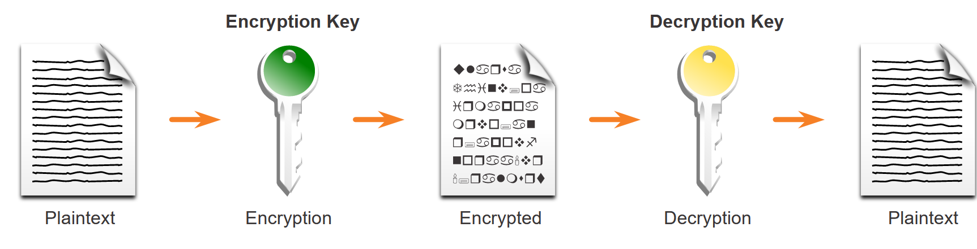
Asymmetric Encryption
Asymmetric algorithms, also called public-key algorithms, are designed so that the key that is used for encryption is different from the key that is used for decryption, as shown in the figure. The decryption key cannot, in any reasonable amount of time, be calculated from the encryption key and vice versa.
Examples of protocols that use asymmetric key algorithms include:
Internet Key Exchange (IKE) - This is a fundamental component of IPsec VPNs.
Secure Socket Layer (SSL) - This is now implemented as IETF standard Transport Layer Security (TLS).
Secure Shell (SSH) - This protocol provides a secure remote access connection to network devices.
Pretty Good Privacy (PGP) - This computer program provides cryptographic privacy and authentication. It is often used to increase the security of email communications.

Slide 38
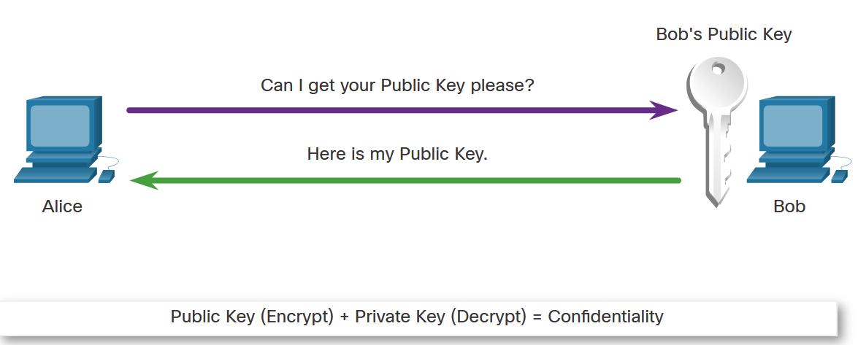
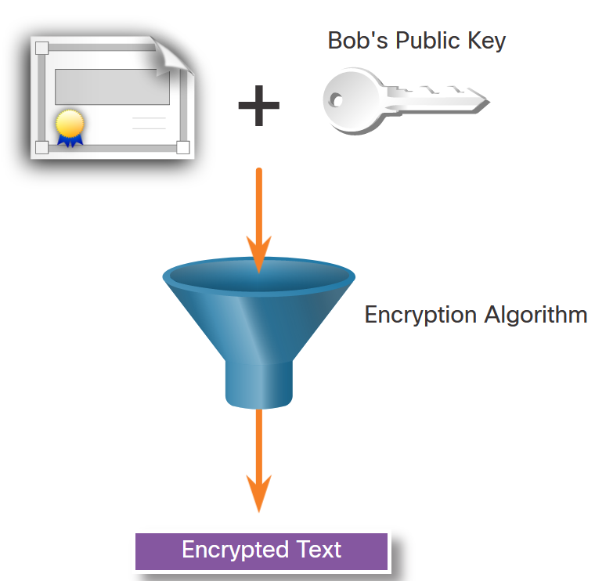
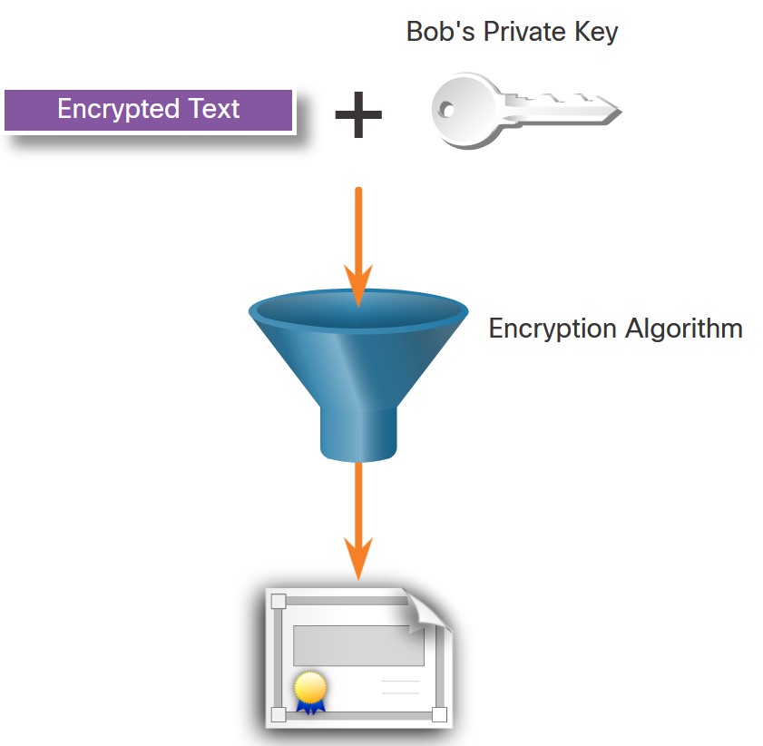
Asymmetric Encryption - Confidentiality
The process can be summarized using the formula:
Public Key (Encrypt) + Private Key (Decrypt) = Confidentiality
When the public key is used to encrypt the data, the private key must be used to decrypt the data. Only one host has the private key; therefore, confidentiality is achieved.
Alice requests and obtains Bob’s public key.
Alice uses Bob’s public key to encrypt a message using an agreed-upon algorithm. Alice sends the encrypted message to Bob.
Bob then uses his private key to decrypt the message. Since Bob is the only one with the private key, Alice's message can only be decrypted by Bob and thus confidentiality is achieved.

Slide 39
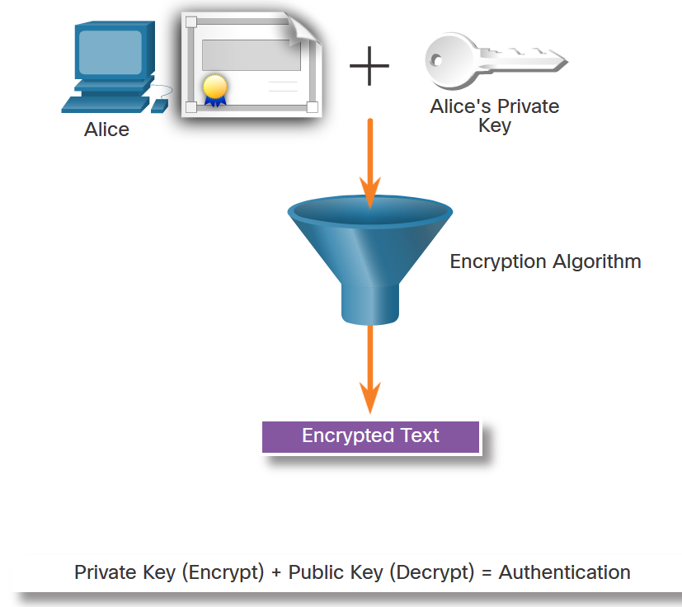
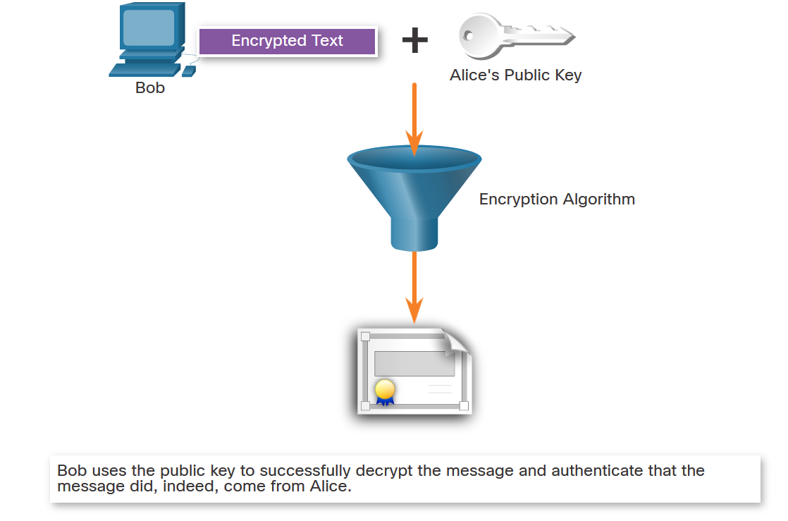
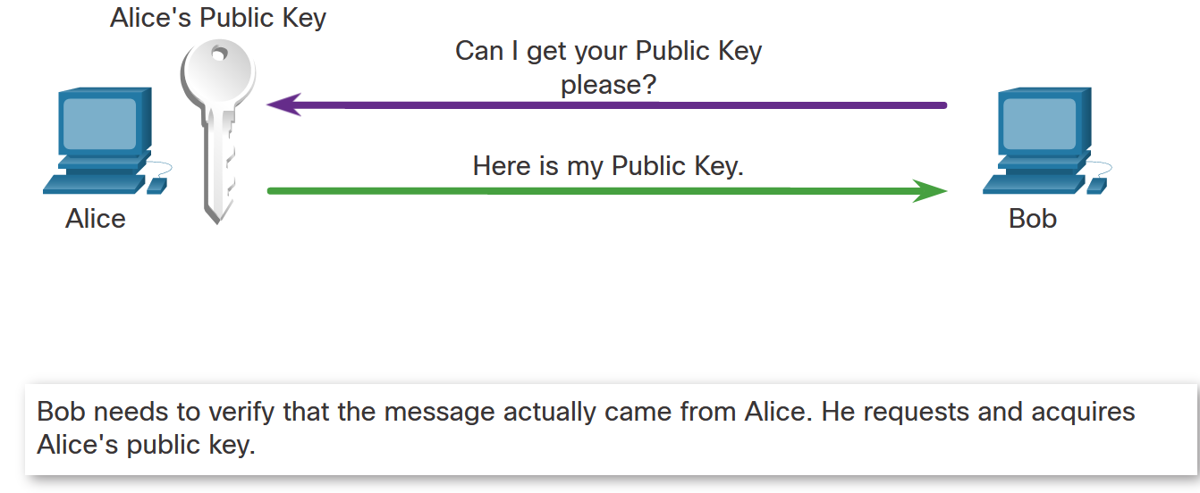
Asymmetric Encryption - Authentication
The authentication objective of asymmetric algorithms is initiated when the encryption process is started with the private key.
The process can be summarized using the formula:
Private Key (Encrypt) + Public Key (Decrypt) = Authentication
Alice encrypts a message using her private key. Alice sends the encrypted message to Bob. Bob needs to authenticate that the message did indeed come from Alice.
In order to authenticate the message, Bob requests Alice’s public key.
Bob uses Alice’s public key to decrypt the message.

Slide 40
RSA: another important property
The following property will be very useful later:
-
+
+
-
K (K (m)) = m
=
K (K (m))
B
B
B
B
use public key first, followed by private key
use private key first, followed by public key
result is the same!

Slide 41
RSA in practice: session keys
exponentiation in RSA is computationally intensive
DES is at least 100 times faster than RSA
use public key crypto to establish secure connection, then establish second key – symmetric session key – for encrypting data
session key, K_{S}
Bob and Alice use RSA to exchange a symmetric session key K_{S}
once both have K_{S}, they use symmetric key cryptography

Slide 42

Digital signatures
cryptographic technique analogous to hand-written signatures:
sender (Bob) digitally signs document: he is document owner/creator.
verifiable, nonforgeable: recipient (Alice) can prove to someone that Bob, and no one else (including Alice), must have signed document
simple digital signature for message m:
Bob signs m by encrypting with his private key K_{B}, creating “signed” message, K_{B}⁻(m)
-
Bob’s private
key
-
Bob’s message, m
K
m,K
(m)
B
B
Dear Alice
Oh, how I have missed you. I think of you all the time! …(blah blah blah)
Bob
Dear Alice
Oh, how I have missed you. I think of you all the time! …(blah blah blah)
Bob
Public key
encryption
algorithm
-
K
(m)
B

Slide 43
Digital signatures
-
suppose Alice receives msg m, with signature: m, K_{B}(m)
Alice verifies m signed by Bob by applying Bob’s public key K_{B} to K_{B}(m) then checks K_{B}(K_{B}(m) ) = m.
If K_{B}(K_{B}(m) ) = m, whoever signed m must have used Bob’s private key
+
-
+
-
+
-
Alice thus verifies that:
Bob signed m
no one else signed m
Bob signed m and not m’
non-repudiation:
Alice can take m, and signature K_{B}(m) to court and prove that Bob signed m
-

Slide 44
Message digests
computationally expensive to public-key-encrypt long messages
goal: fixed-length, easy- to-compute digital “fingerprint”
apply hash function H to m, get fixed size message digest, H(m)
large
message
m
H: Hash
Function
H(m)
Hash function properties:
many-to-1
produces fixed-size msg digest (fingerprint)
given message digest x, computationally infeasible to find m such that x = H(m)

Slide 45
Digital signature = signed message digest
Bob sends digitally signed message:
Alice verifies signature, integrity of digitally signed message:
large
message
m
H: Hash
Function
H(m)
encrypted
message digest
-
K_{B}(H(m))
digital
signature
(encrypt)
Bob’s
private
key
large
message
m
-
K
B
digital
signature
(decrypt)
Bob’s
public
key
+
encrypted
message digest
H: Hash
function
K
B
+
-
K_{B}(H(m))
H(m)
H(m)
?
equal

Slide 46
Hash function algorithms
MD5 hash function widely used (RFC 1321)
computes 128-bit message digest in 4-step process.
arbitrary 128-bit string x, appears difficult to construct msg m whose MD5 hash is equal to x
SHA-1 is also used
US standard [NIST, FIPS PUB 180-1]
160-bit message digest

Slide 47
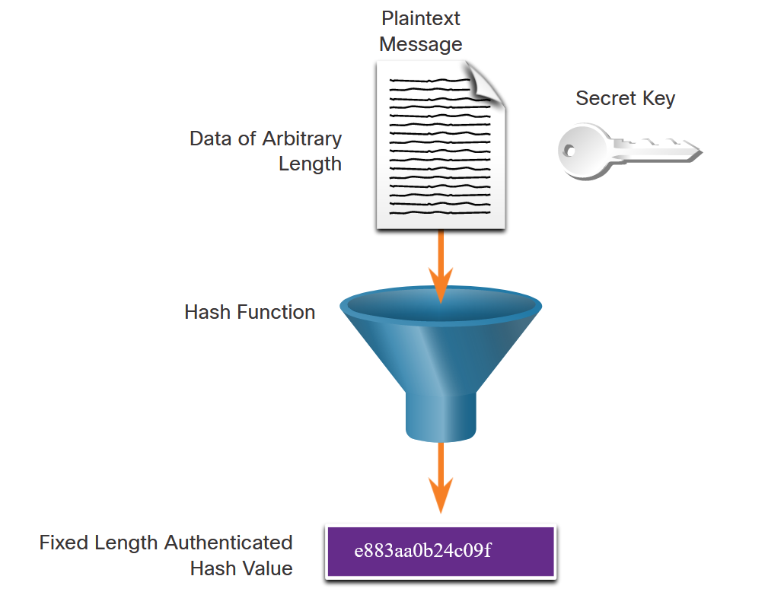
Origin Authentication
To add origin authentication and integrity assurance, use a keyed-hash message authentication code (HMAC). HMAC uses an additional secret key as input to the hash function.
As shown in the figure, an HMAC is calculated using any cryptographic algorithm that combines a cryptographic hash function with a secret key. Hash functions are the basis of the protection mechanism of HMACs.
Only the sender and the receiver know the secret key, and the output of the hash function now depends on the input data and the secret key. Only parties who have access to that secret key can compute the digest of an HMAC function. This defeats man-in-the-middle attacks and provides authentication of the data origin.

Slide 48
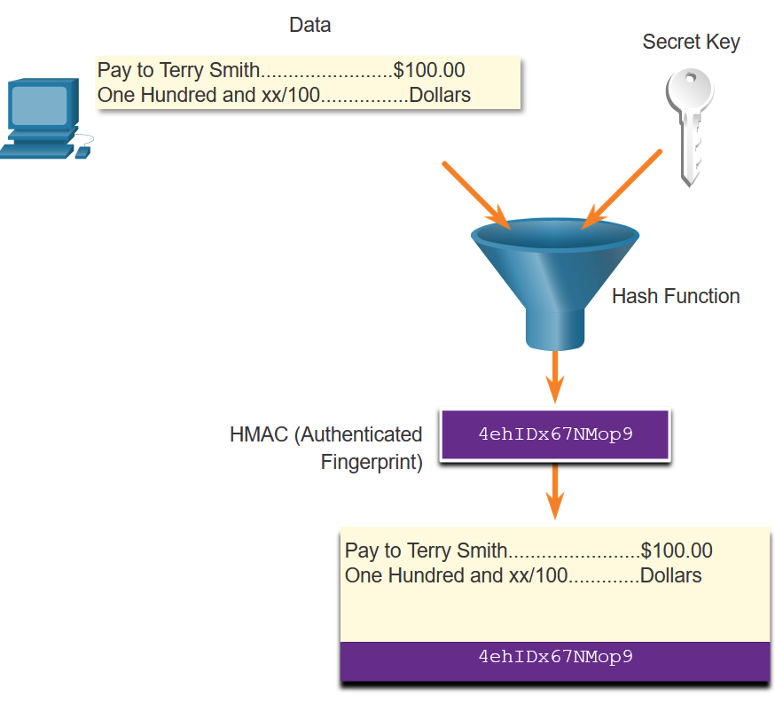
Integrity and Authenticity
Origin Authentication (Cont.)
As shown in the figure, the sending device inputs data (such as Terry Smith’s pay of $100 and the secret key) into the hashing algorithm and calculates the fixed-length HMAC digest. This authenticated digest is then attached to the message and sent to the receiver.

Slide 49
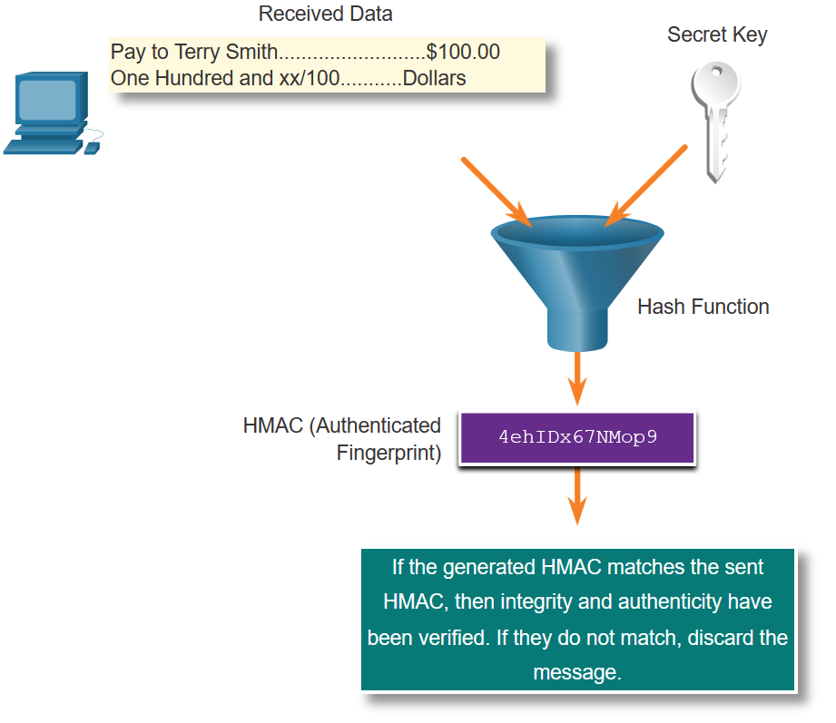
Integrity and Authenticity
Origin Authentication (Cont.)
In the figure, the receiving device removes the digest from the message and uses the plaintext message with its secret key as input into the same hashing function. If the digest that is calculated by the receiving device is equal to the digest that was sent, the message has not been altered. Additionally, the origin of the message is authenticated because only the sender possesses a copy of the shared secret key. The HMAC function has ensured the authenticity of the message.

Slide 50
Switch Security

Slide 51
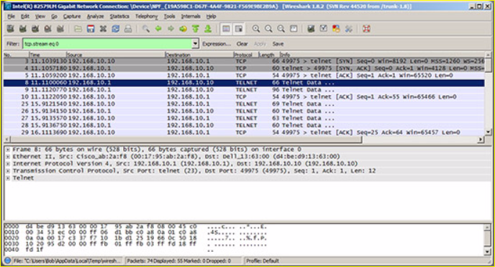
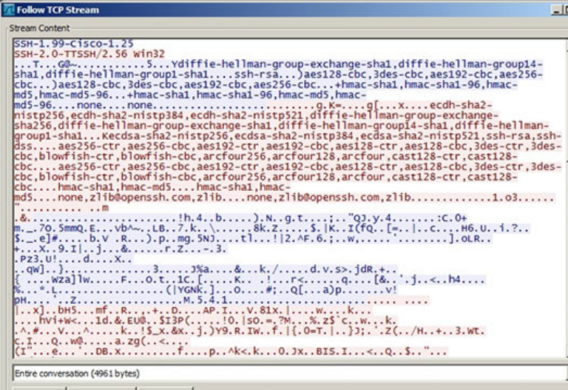
Secure Remote Access SSH Operation
Secure Shell (SSH)
An alternative protocol to Telnet. Telnet uses unsecure plaintext of the username and password as well as the data transmitted.
SSH is more secure because it provides an encrypted management connection.
Wireshark Capture of Telnet
Wireshark Capture of SSH

Slide 52
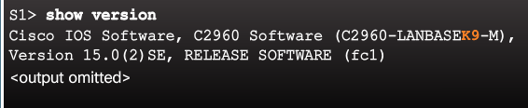
Secure Remote Access SSH Operation (Cont.)
A switch must have an IOS version (k9 at the end of the IOS file name) that includes cryptographic capabilities in order to configure and use SSH.
Use the show version command to see the IOS version.

Slide 53
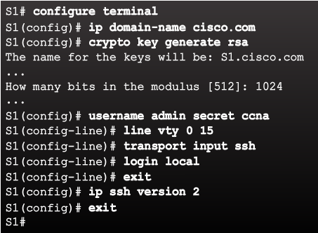
Secure Remote Access Configuring SSH
Commonly forgotten command that is used in key generation
Verify SSH support.
Configure the IP domain name.
Generate RSA key pairs.
Configure user authentication.
Configure the vty lines.
Enable SSH version 2.
Default is to accept both Telnet and SSH (transport input all)
The login local command forces the use of the local database for username/ password.

Slide 54
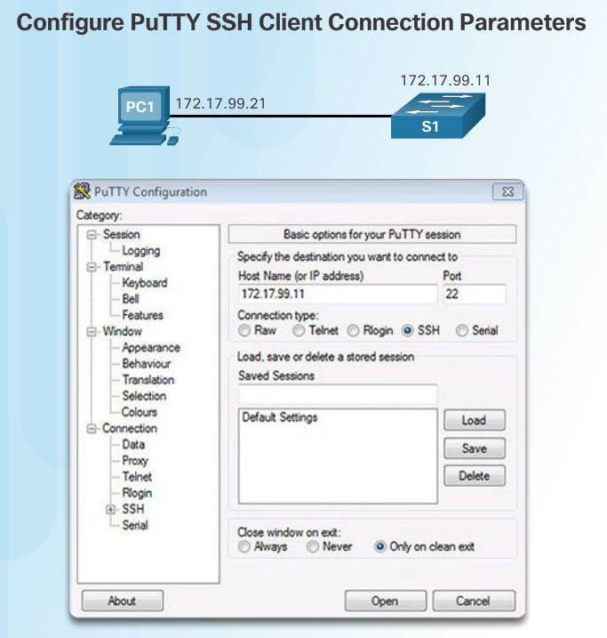
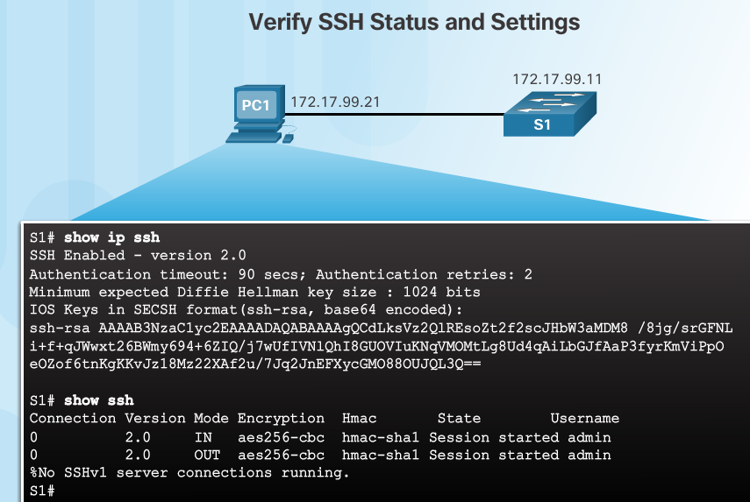
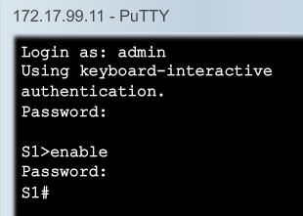
Secure Remote Access Verifying SSH
On the PC, connect to the switch using SSH.
Switch IP address
The PC is using SSH to communicate and issue commands on the switch.

Slide 55
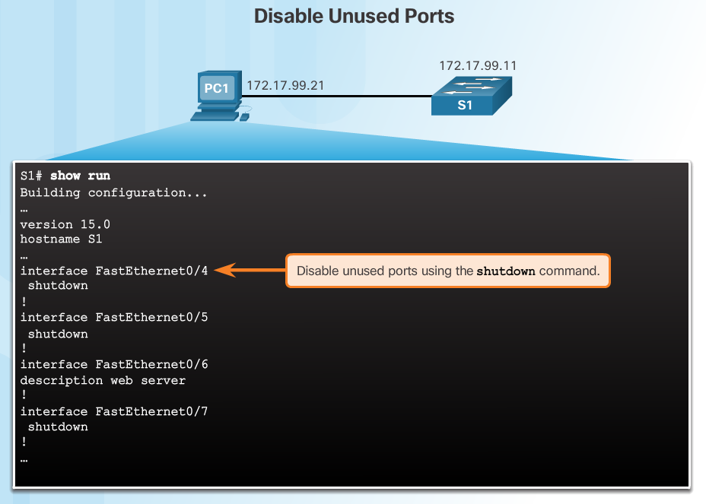
Switch Port Security Secure Unused Ports
The interface range command can be used to apply a configuration to several switch ports at one time.

Slide 56
Switch Port Security Port Security: Operation
Port security limits the number of valid MAC addresses allowed to transmit data through a switch port.
If a port has port security enabled and an unknown MAC address sends data, the switch presents a security violation.
Default number of secure MAC addresses allowed is 1.
Methods use to configure MAC addresses within port security:
Static secure MAC addresses – manually configure
switchport port-security mac-address mac-address
Dynamic secure MAC addresses – dynamically learned and removed if the switch restarts
Sticky secure MAC addresses – dynamically learned and added to the running configuration (which can later be saved to the startup-config to permanently retain the MAC addresses)
switchport port-security mac-address sticky mac-address
Note: Disabling sticky learning converts sticky MAC addresses to dynamic secure addresses and removes them from the running-config.

Slide 57
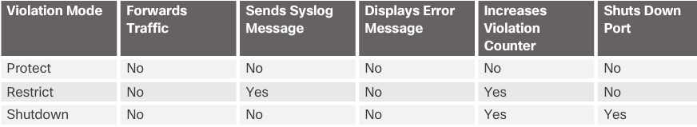
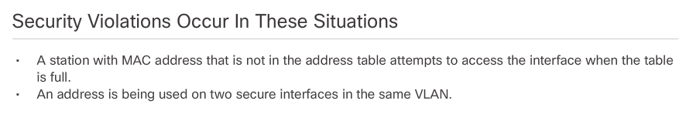
Switch Port Security Port Security: Violation Modes
Protect – data from unknown source MAC addresses are dropped; a security notification IS NOT presented by the switch
Restrict - data from unknown source MAC addresses are dropped; a security notification IS presented by the switch and the violation counter increments.
Shutdown – (default mode) interface becomes error-disabled and port LED turns off. The violation counter increments. Issues the shutdown and then the no shutdown command on the interface to bring it out of the error-disabled state.

Slide 58
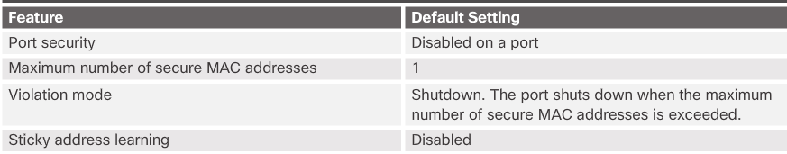
Switch Port Security Port Security: Configuring

Slide 59
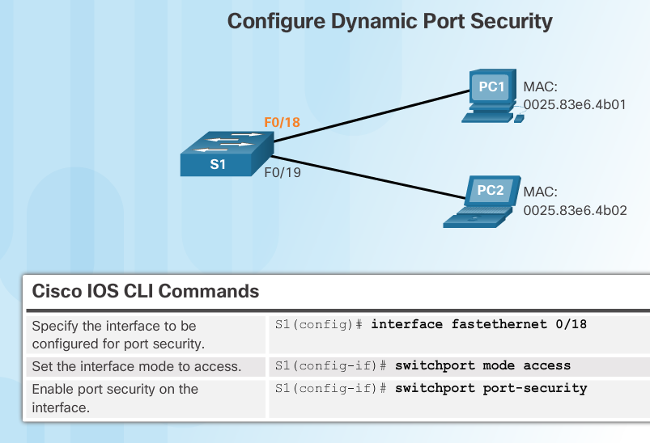
Switch Port Security Port Security: Configuring (Cont.)
Before configuring port-security features, place the port in access mode and use the switchport port-security interface configuration command to enable port security on an interface.

Slide 60
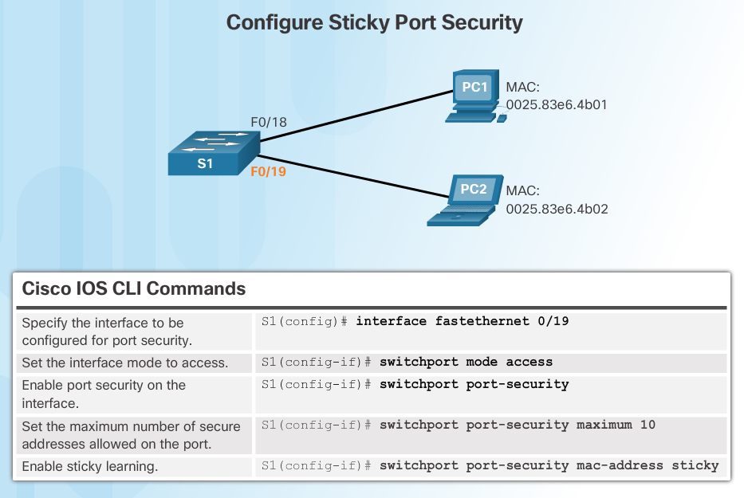
Switch Port Security Port Security: Configuring (Cont.)

Slide 61
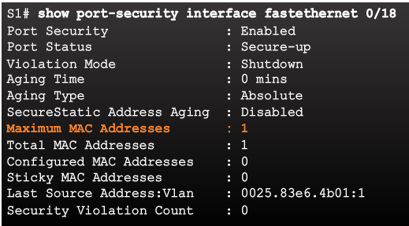
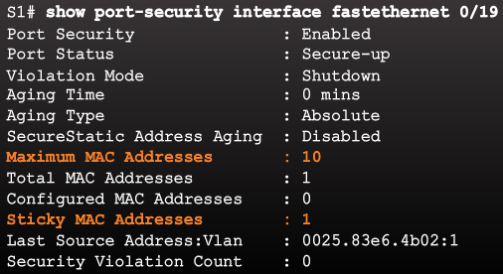
Switch Port Security Port Security: Verifying
Use the show port-security interface command to verify the maximum number of MAC addresses allowed on a particular port and how many of those addresses were learned dynamically using sticky.
Dynamic
Sticky

Slide 62
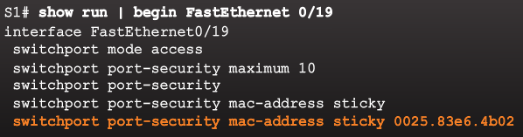
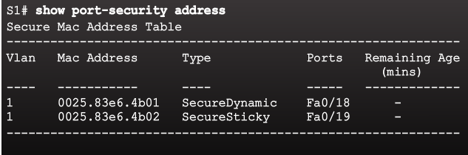
Switch Port Security Port Security: Verifying (Cont.)
Use the show running-config command to see learned MAC addresses added to the configuration. The show port-security address command shows how MAC addresses were learned on a particular port.

Slide 63
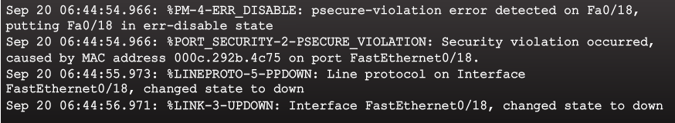
Switch Port Security Ports in Error Disabled State
Switch console messages display when a port security violation occurs. Notice the port link status changes to down.

Slide 64
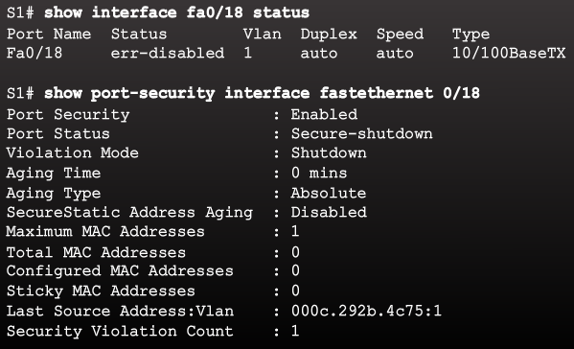
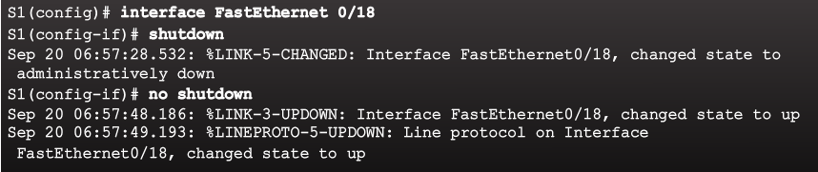
Switch Port Security Ports in Error Disabled State (Cont.)
Check the port status and the port security settings.
Do not re-enable a port until the security threat is investigated and eliminated.
Notice that you must first shut the port down and then issue the no shutdown command in order to use the particular port again after a security violation has occurred.

